Slide 1

Stock Price Prediction
Using Machine Learning Algorithms

Slide 2
Table of contents
01
Introduction
02
Proposed system
03
Patient Care
04
Results
An overview of what the project is all about.
Time-series prediction is the concept widely used in many real world application
You can describe the topic of the section here
What we achieved and future goals for the project

Slide 3
Whoa!
HEY, MY NAME Is Pankaj Singh
Currently pursuing B tech in computer science and Information technology from KIET group of Institutions.

Slide 4

01
Let’s Start
Stock Price prediction using Machine Learning.

Slide 5
Abstract
In this project we attempt to implement machine learning approach to predict stock prices. Machine learning is effectively implemented in forecasting stock prices. The objective is to predict the stock prices in order to make more informed and accurate investment decisions. We propose a stock price prediction system that integrates mathematical functions, machine learning, and other external factors for the purpose of achieving better stock prediction accuracy and issuing profitable trades. There are two types of stocks. You may know of intraday trading by the commonly used term "day trading." Interday traders hold securities positions from at least one day to the next and often for several days to weeks or months. LSTMs are very powerful in sequence prediction problems because they’re able to store past information. This is important in our case because the previous price of a stock is crucial in predicting its future price. While predicting the actual price of a stock is an uphill climb, we can build a model that will predict whether the price will go up or down.

Slide 6

Introduction
A stock market is a Public market where you can buy and sell shares for publicly listed companies. The stocks, also known as equities, represent ownership in the company. The stock exchange is the mediator that allows the buying and selling of shares.

Slide 7

Stock Price Prediction
Stock Price Prediction using machine learning helps you discover the future value of company stock and other financial assets traded on an exchange. The entire idea of predicting stock prices is to gain significant profits. Predicting how the stock market will perform is a hard task to do. There are other factors involved in the prediction, such as physical and psychological factors, rational and irrational behavior, and so on. All these factors combine to make share prices dynamic and volatile. This makes it very difficult to predict stock prices with high accuracy.

Slide 8
Mission and vision
Mission
Vision
Our mission is to be able to predict the stock prices of some major companies with accuracy of 95 percent.
We further want this project to be able to predict prices for cryptocurrencies and index stocks.

Slide 9

— Benjamin Franklin
“An investment in knowledge pays the best interest.”
When it comes to investing, nothing will pay off more than educating yourself. Do the necessary research and analysis before making any investment decisions.

Slide 10

A brief story
We used Time-series prediction in which it uses the continous data in a period of time to predict the result in the next time unit.
Only open price is considered for processing.
We have used the following ML algorithms :
Simple linear Regression
Support vector Regression
Decision tree Regression
Random forest Regression

Slide 11
Our process
01
Data set
Algorithm selection
03
Data set is taken from Kaggle.
Extension type .csv
Using Sklearn we use the algorithm to predict preices
02
Pre Processing
Accuracy
04
Data cleaning &
Data visualization is done here.
Predict the Price using the highest accuracy model

Slide 12
Simple Linear Regression
Simple linear regression is a statistical method that is used to examine the relationship between a dependent variable (also known as the outcome or response variable) and one or more independent variables (also known as predictor or explanatory variables). It is called "simple" linear regression because it involves only one independent variable. The basic idea behind simple linear regression is to find the best-fitting straight line through the data points. This line is represented by the equation:
y = b0 + b1*x
Where : y is the dependent variable x is the independent variableb0 is the y-intercept (the point at which the line crosses the y-axis)b1 is the slope of the line (the change in y for a change of 1 unit in x)The goal of simple linear regression is to find the values of b0 and b1 that minimize the differences (or residuals) between the predicted values of y (based on the equation above) and the actual values of y. Simple linear regression can be used for a variety of tasks such as predicting future values, understanding the relationship between variables, and identifying outliers. However, it's important to keep in mind that this method makes several assumptions such as linearity, independence, and homoscedasticity between the predictor and the outcome variable, that should be met before using it.

Slide 13
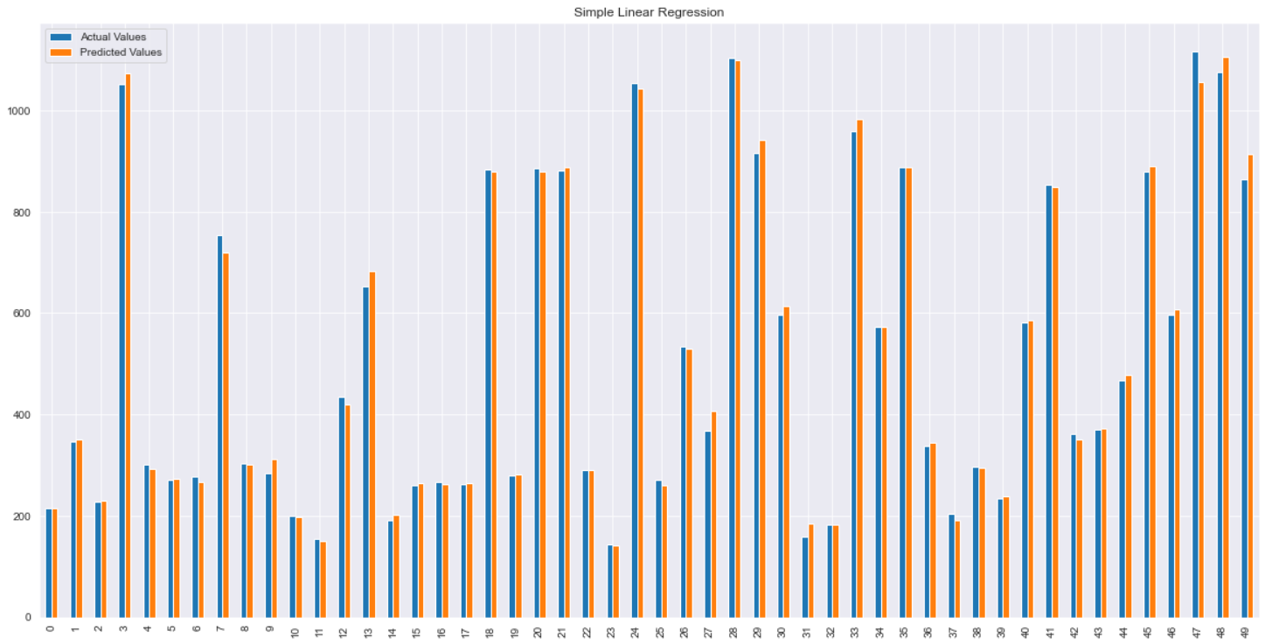

Slide 14
Support Vector Regression
Support Vector Regression (SVR) is a type of support vector machine (SVM) that is used for performing regression tasks. Like other SVM methods, SVR is a supervised learning algorithm that can be used for both linear and nonlinear regression. In SVR, the goal is to find the best line (in the case of linear regression) or hyperplane (in the case of nonlinear regression) that maximizes the margin between the data points and the line/hyperplane. The margin is the distance between the line/hyperplane and the closest data points, also known as support vectors. The main difference between SVR and other linear regression models is that SVR allows for the introduction of a ”slack variable” which permits some of the data points to be within the margin, hence it’s more robust to outliers. SVR is often used in applications where the number of input variables is high, and the data is noisy, or where the relationship between the input and output variables is nonlinear. However, it can be sensitive to the choice of kernel, and the values of the parameters, thus it requires a careful tuning of the parameters. In summary, SVR is a regression algorithm that is based on the principles of support vector machines, which aims to find the best hyperplane that separates the data while maximizing the margin between the data points and the hyperplane. It’s a robust method that can handle non-linearity and outliers, but it can be sensitive to the choice of kernel and the parameters.

Slide 15
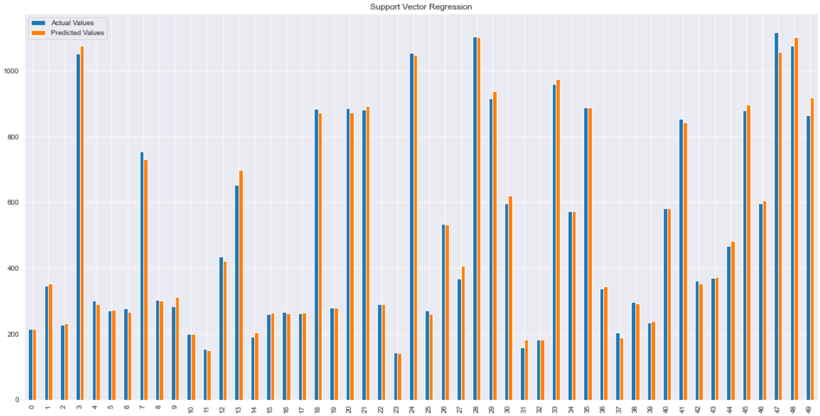

Slide 16
Decision Tree Regression
Decision tree regression is a method that uses a decision tree as a predictive model to predict a continuous target variable. It is a type of supervised learning algorithm that can be used for both classification and regression tasks. A decision tree is a tree-like model of decisions and their possible consequences, including chance event outcomes, resource costs, and utility. Each internal node of the tree represents a ”test” on an attribute, each branch represents the outcome of the test, and each leaf node represents a class label (in the case of classification) or a value (in the case of regression). In decision tree regression, the goal is to create a model that predicts the value of a target variable by learning simple decision rules inferred from the data features. Each internal node of the tree represents a test on a feature, and each leaf node represents a predicted value of the target variable. The tree is built by recursively splitting the data into subsets based on the values of the input features, starting from the root node and going to the leaf nodes. The decision tree algorithm uses a metric such as mean squared error (MSE) to decide the best split point for each feature. The tree continues to grow until a stopping criterion is met, such as a maximum tree depth or a minimum number of samples in a leaf node. Decision tree regression can be useful for tasks such as predicting future values, understanding the relationship between variables, and identifying important features. However, it’s important to note that decision trees are prone to overfitting, especially when the tree becomes too deep, it’s important to use techniques such as pruning to avoid this issue.

Slide 17
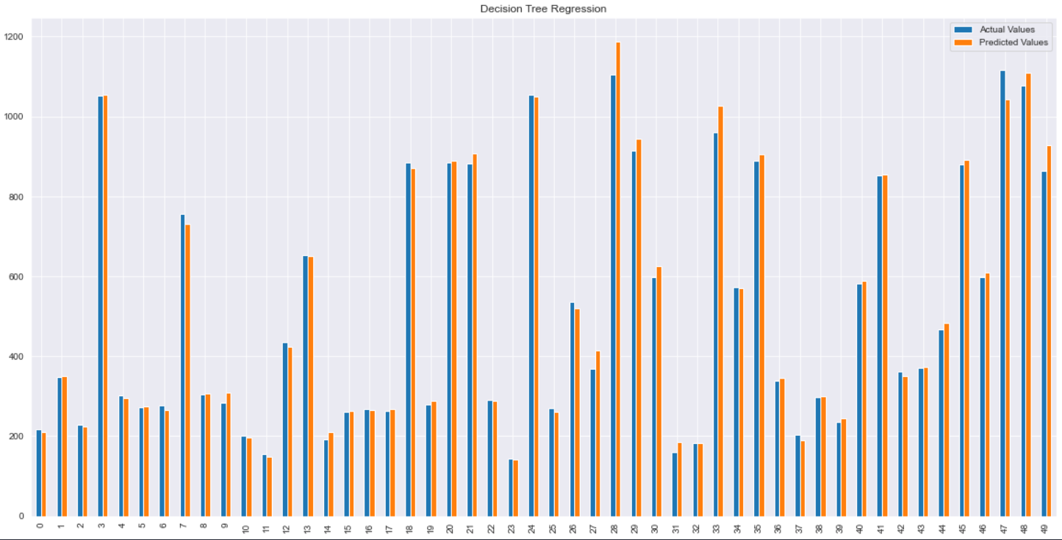

Slide 18
Random Forest Regression
Random Forest Regression is an ensemble method that combines multiple decision trees to make predictions. It is a type of supervised learning algorithm that can be used for both classification and regression tasks. In a Random Forest model, a large number of decision trees are trained on different subsets of the training data and the final prediction is made by averaging the predictions of all the trees. This averaging process helps to reduce the variance and improve the generalization error of the model. Each tree in the forest is grown using a random subset of the training data, and a random subset of the features. This process is known as bootstrap aggregating or bagging, and it helps to decorrelate the trees, making the ensemble more robust. The training process of a random forest is done by repeating the following steps: 1.Select N random samples from the dataset with replacement 2.Grow a decision tree from the subsample 3.Repeat steps 1-2 for a certain number of times 4. Average the prediction of all the decision trees. The Random Forest Regression model can be useful for tasks such as predicting future values, understanding the relationship between variables, and identifying important features. It’s also a robust method to handle overfitting, it’s less prone to overfitting than decision tree regression and it can handle categorical variables.

Slide 19
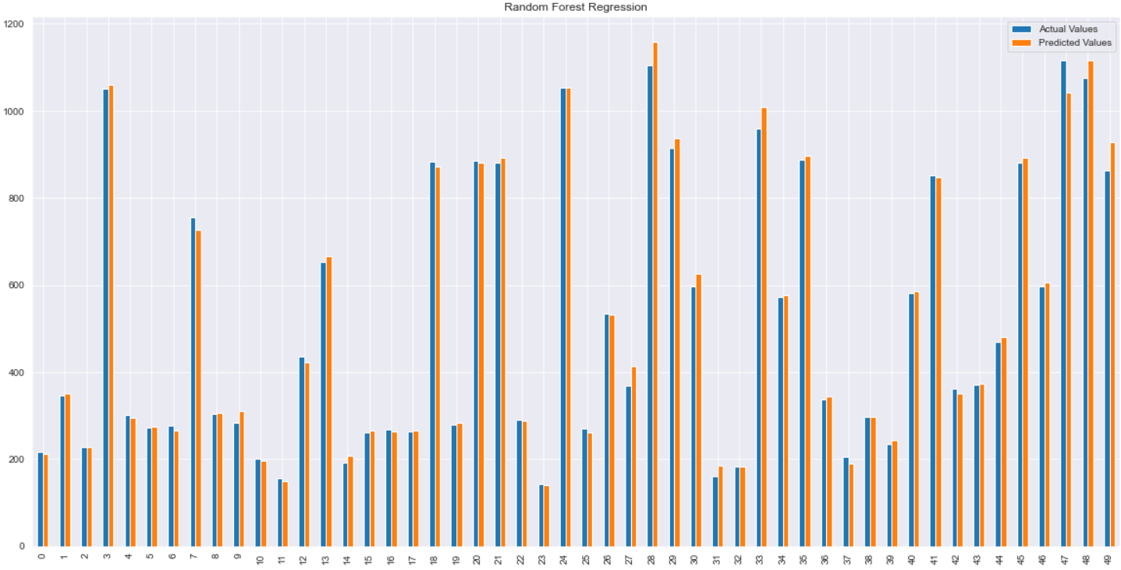

Slide 20
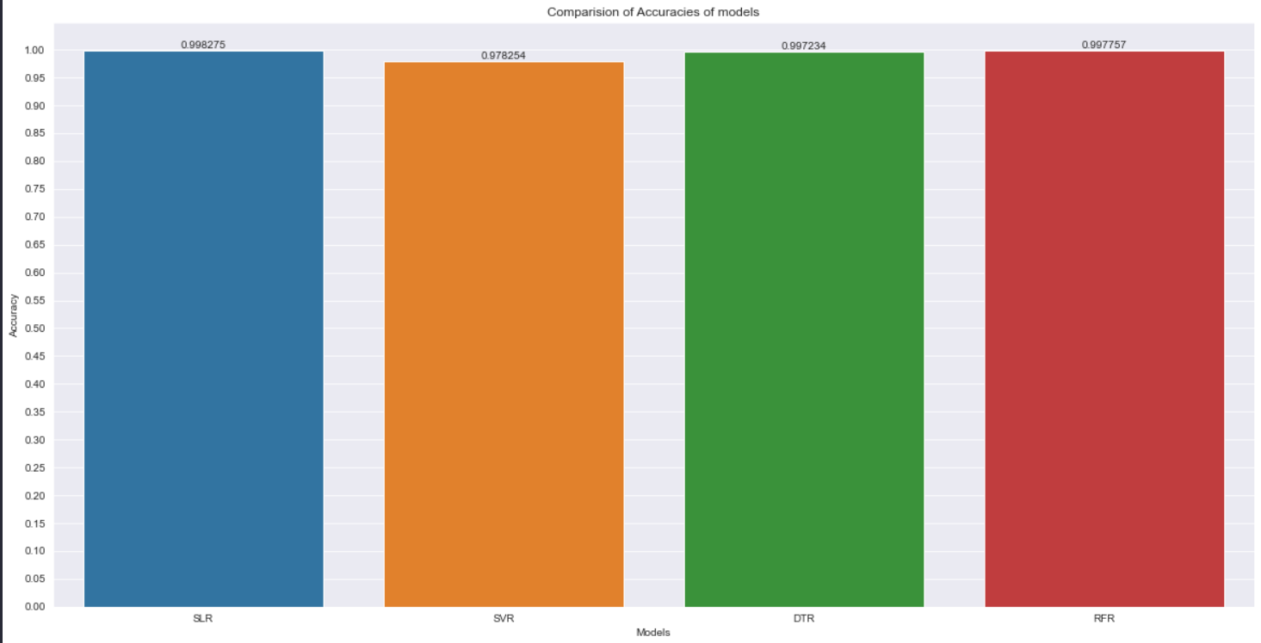

Slide 21
Accuracy of Models
99.8%
93.6%
97.2%
SLR
SVR
DTR
Simple Linear
Regression
Support Vector
Regression
Decision Tree
Regression

Slide 22
This is a table
 | Actual values | Predicted values
1. | 215.88000 | 215.76174
2. | 346.60000 | 351.79488
3. | 227.75000 | 229.94435
4. | 1051.5500 | 1072.91031
Example of some of the stocks .
Where on the left are the actual values and on the right side there is predicted values.

Slide 23
Literature review report Research papers 1 . Stock Market Prediction Using Machine Learning The research work done by V Kranthi Sai Reddy Student, ECM, Sreenidhi Institute of Science and Technology, Hyderabad, India. In the finance world stock trading is one of the most important activities. Stock market prediction is an act of trying to determine the future value of a stock other financial instrument traded on a financial exchange. This paper explains the prediction of a stock using Machine Learning. The technical and fundamental or the time series analysis is used by the most of the stockbrokers while making the stock predictions. The programming language is used to predict the stock market using machine learning is Python. In this paper we propose a Machine Learning (ML) approach that will be trained from the available stocks data and gain intelligence and then uses the acquired knowledge for an accurate prediction. In this context this study uses a machine learning technique called Support Vector Machine (SVM) to predict stock prices for the large and small capitalizations and in the three different markets, employing prices with both daily and up-to-the-minute frequencies.

Slide 24
2 . The Stock Market and Investment
The research work done by Manh Ha Duong Boriss Siliverstovs. Investigating the relation between equity prices and aggregate investment in major European countries including France, Germany, Italy, the Netherlands and the United Kingdom. Increasing integration of European financial markets is likely to result in even stronger correlation between equity prices in different European countries. This process can also lead to convergence in economic development across European countries if developments in stock markets influence real economic components, such as investment and consumption. Indeed, our vector autoregressive models suggest that the positive correlation between changes equity prices and investment is, in general, significant. Hence, 6 monetary authorities should monitor reactions of share prices to monetary policy and their effects on the business cycle.

Slide 25
3 . Stock Price Correlation Coefficient Prediction with ARIMALSTM Hybrid Model
The research work done by Hyeong Kyu Choi, B.A Student Dept. of Business Administration Korea University Seoul, Korea. Predicting the price correlation of two assets for future time periods is important in portfolio optimization. We apply LSTM recurrent neural networks (RNN) in predicting the stock price correlation coefficient of two individual stocks. RNN’s are competent in understanding temporal dependencies. The use of LSTM cells further enhances its long-term predictive properties. To encompass both linearity and nonlinearity in the model, we adopt the ARIMA model as well. The ARIMA model filters linear tendencies in the data and passes on the residual value to the LSTM model. The ARIMA-LSTM hybrid model is tested against other traditional predictive financial models such as the full historical model, constant correlation model, single-index model and the multi-group model. In our empirical study, the predictive ability of the ARIMA-LSTM model turned out superior to all other financial models by a significant scale. Our work implies that it is worth considering the ARIMALSTM model to forecast correlation coefficient for portfolio optimization.

Slide 26
4 . Indian stock market prediction using artificial neural networks on tick data
The research work done by Dharmaraja Selvamuthu, Vineet Kumar and Abhishek Mishra Department of Mathematics, Indian Institute of Technology Delhi, Hauz Khas, New Delhi 110016, India. A stock market is a platform for trading of a company’s stocks and derivatives at an agreed price. Supply and demand of shares drive the stock market. In any country stock market is one of the most emerging sectors. Nowadays, many people are indirectly or directly related to this sector. Therefore, it becomes essential to know about market trends. Thus, with the development of the stock 5 market, people are interested in forecasting stock price. But, due to dynamic nature and liable to quick changes in stock price, prediction of the stock price becomes a challenging task. Stock m Prior work has proposed effective methods to learn event representations that can capture syntactic and semantic information over text corpus, demonstrating their effectiveness for downstream tasks such as script event prediction. On the other hand, events extracted from raw texts lacks of common-sense knowledge, such as the intents and emotions of the event participants, which are useful for distinguishing event pairs when there are only subtle differences in their surface realizations. To address this issue, this paper proposes to leverage external common-sense knowledge about the intent and sentiment of the event.

Slide 27
5 . Automated Stock Price Prediction Using Machine Learning
The research work done by Mariam Moukalled Wassim El-Hajj Mohamad Jaber Computer Science Department American University of Beirut. Traditionally and in order to predict market movement, investors used to analyse the stock prices and stock indicators in addition to the news related to these stocks. Hence, the importance of news on the stock price movement. Most of the previous work in this industry focused on either classifying the released market news as (positive, negative, neutral) and demonstrating their effect on the stock price or focused on the historical price movement and predicted their future movement. In this work, we propose an automated trading system that integrates mathematical functions, machine learning, and other external factors such as news’ sentiments for the purpose of achieving better stock prediction accuracy and issuing profitable trades. Particularly, we aim to determine the price or the trend of a certain stock for the coming end-of-day considering the first several trading hours of the day. To achieve this goal, we trained traditional machine learning algorithms and created/trained multiple deep learning models taking into consideration the importance of the relevant news. Various experiments were conducted, the highest accuracy (82.91%) of which was achieved using SVM for Apple Inc. (AAPL) stock.

Slide 28
Resources Used
Python
Jupyter
Numpy
Pandas
Matplotlib
SK Learn

Slide 29

Profile
Pankaj Singh
CSIT 6-B
Roll no. 2100290110107
2125CSIT1098

Slide 30
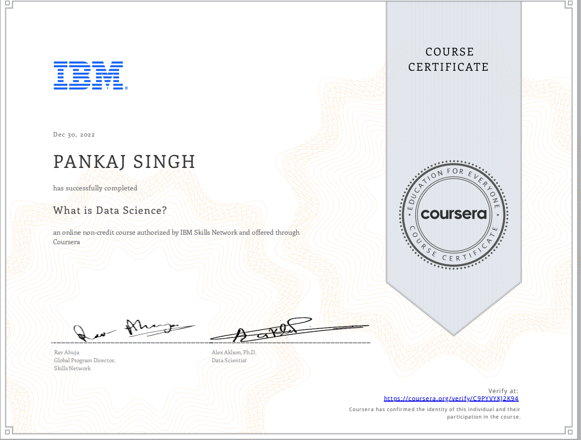

Slide 31


Slide 32
Thanks
Do you have any questions?
Naman.2125cse1073@kiet.edu| 8958358638 |KIET group of Institutions
Hope you have a wonderful day ahead …

